Slide 1
Financial Modeling using Signal Processing: A Unified Framework
Subhanshu Choudhary
22b3980

Slide 2
Why Traditional Finance Needs
Signal Processing ?
THE DATA EXPLOSION IN THIS CENTURY:
High-Frequency Trading: Tick data every millisecond
Cross-Asset Dependencies: Thousands of correlated securities
Non-Stationary Dynamics: Political event, volatility clustering
Computational Constraints: Real-time portfolio rebalancing
Problem | Traditional Approach | Issues
Correlation Noise | Sample covariance | O(N³) cost
Multi-Scale Patterns | Single timeframe | Misses trends
Trend Detection | Moving averages | Lags behind
Jump Events | Ignored/outliers | Poorly managed crisis

Slide 3
Don’t worry.
CSP is here!
Signal processing techniques
(DCT, EMD, Particle Filters)
naturally handle these challenges!

Slide 4
THREE COMPLEMENTARY APPROACHES TO FINANCIAL MODELING

Slide 5
PAPER 1: TOEPLITZ/DCT Akansu & Torun (2012) - Portfolio Risk via Transform Methods
PROBLEM: Correlation matrix estimation is O(N³) bottleneck
SOLUTION: Toeplitz structure + DCT transform
RESULT: 97% of KLT performance, 200× faster
DOMAIN: Spatial (cross-asset correlation structure)
DATA: 31 DJIA stocks, 60-day rolling windows
KEY METRIC: Compaction efficiency η_{c} = 0.142

Slide 6
PAPER 2: π-COUNTING IF & EMD Zhang, Liu & Yu (2012) - Stock Prediction via Decomposition
PROBLEM: Hilbert Transform gives negative frequencies
SOLUTION: π-counting IF + EMD + RBF neural networks
RESULT: 99.3% error reduction vs. backpropagation
DOMAIN: Temporal (multi-scale frequency analysis)
DATA: Hang Seng Index, 253 days (150 train/35 test)
KEY METRIC: SSE = 0.0087 (vs. 1.2560 for BP)

Slide 7
PAPER 3: LANGEVIN JUMP-DIFFUSION Christensen, Murphy & Godsill (2012) - HFT via Particle Filtering
PROBLEM: Momentum strategies need trend + jumps
SOLUTION: Langevin SDE + Variable Rate Particle Filter
RESULT: Sharpe 1.83 post-cost (83% > hedge funds)
DOMAIN: Continuous-time dynamics (real-time tracking)
DATA: 75 futures contracts, 5 years daily + HF intraday
KEY METRIC: Sharpe scales to 2.30 at 1-min frequency

Slide 8
WHAT THIS RESEARCH ACHIEVES
1. DEEP MATHEMATICAL ANALYSIS
Complete derivations of all key theorems
Closed-form solutions (AR(1), Kalman, transitions)
Complexity analysis (O(N³) → O(N log N))
2. IDENTIFY MATHEMATICAL CONNECTIONS
Toeplitz ↔ AR(1) process (Paper 1)
Simple Waves ↔ IMFs (Paper 2)
Rao-Blackwellization ↔ Conditional Gaussianity (Paper 3)
3. PROPOSE UNIFIED FRAMEWORK AND EMPIRICAL VALIDATION
10 assets (AAPL, MSFT, GOOGL, AMZN, META, JPM...)
2 years of daily data (2023-2025)
All three methods + integrated system tested

Slide 9
PAPER 1: TOEPLITZ APPROXIMATION FOR PORTFOLIO RISK
CORE INNOVATION:
Modern portfolios have N = 100-1000+ assets
Empirical correlation matrix: Remp = (1/T)∑_{t}rₜrₜ^{T}
Eigendecomposition for risk: σ_{p}² = ∑_{k}𝛌_{k}(v_{k}^{T}w)²
Computational cost: O(N³) eigendecomposition
Estimation error: SE(ρ^_{ij}) ≈ (1-ρ²)/√T
SOLUTION PATH:
Step 1: Model returns output as AR(1) processes
x(n) = ρx(n-1) + w(n) → r_{X}(k) = σ²ρ^{|k|}
Step 2: Recognize Toeplitz structure
R_{ij} = ρ^{|i-j|} (constant diagonals)
Step 3: Use closed-form eigendecomposition
λ_{k} = (1-ρ²)/(1-2ρcos(θ_{k})+ρ²), θ_{k} = kπ/(N+1)
Step 4: Approximate with DCT
lim_{ₚ→₁} DCT eigenvectors = AR(1) eigenvectors
Step 5: Fast portfolio risk via O(NlogN) transforms
For highly correlated assets (ρ ≥ 0.85), DCT approximates the optimal KLT with 97%+ accuracy while being 200× faster.

Slide 10
THE FUNDAMENTAL CHALLENGE: NOISY CORRELATIONS
EMPIRICAL CORRELATION ESTIMATION:
For N assets with returns r_{k}(t), k=1,... ,N:
R_{emp} = (1/T) Σ^{T}_{t=1}r̄(t)r̄(t)^{T}
where
r̄ₖ(t) = [r_{k}(t) - μ_{k}]/σ_{k} (normalized returns)
THE PROBLEM: R_{emp} = R_{true} + Noise
Standard Error: SE(ρ̂_{ij}) ≈ (1-ρ²_{ij})/√T
Example:
Correlation: ρ = 0.60
Window size: T = 60 days (3 months)
SE(ρ̂) = (1-0.36)/√60 = 0.64/7.75 ≈ 0. 083
95% Confidence Interval: [0.60 ± 1.96×0.083]
= [0.437, 0.763]
Interpretation: True correlation could be
anywhere from 0.44 (weak) to 0.76 (strong)!
FINANCIAL CONSEQUENCE:
Small changes in correlation
estimates → Large
changes in optimal weights
→ Excessive portfolio turnover
→ High transaction costs → Strategy
fails!
SOLUTION PREVIEW:
Toeplitz structure + eigen filtering
reduces
noise by keeping only Q≈5 dominant
factors

Slide 11
WHY CORRELATIONS DOMINATE PORTFOLIO RISK
PORTFOLIO VARIANCE FORMULA:
σₚ² = wᵀRw = ΣᵢΣⱼ wᵢwⱼρᵢⱼσᵢσⱼ
σₚ² = Σ_{i}w²_{i}σ²_{i}+ Σ_{i≠j}w_{i}w_{j}ρ_{ij}σ_{i}σ_{j}
FOR EQUAL-WEIGHTED PORTFOLIO:
w_{i} = 1/N
σₚ² = (1/N)σ̄² + (1 - 1/N)ρ̄σ̄²
where σ̄² = average variance,
ρ̄ = average correlation
AS N → ∞ : σₚ² → ρ̄σ̄²
(Correlation is the ONLY risk that matters!)
EIGENSPACE INTERPRETATION:
σₚ² = Σ^{N}_{k=1}λ_{k}(v_{k}^{T}w)²
where λ_{k} = eigenvalues (factor variances)
v_{k}^{T}w = portfolio exposure to factor k
INSIGHT: Only need Q=5 factors to capture 95% of risk structure!This is why eigen filtering works!
For large N with bounded correlations:
lim_{n→∞}Pr(|σₚ² - ρ̄σ̄²| > ε) = 0
"Diversification eliminates idiosyncratic risk,
only systematic correlation risk remains"

Slide 12
AR(1) MODEL: THE KEY TO TOEPLITZ STRUCTURE
AUTOREGRESSIVE PROCESS OF ORDER 1:
x(n) = ρ·x(n-1) + w(n), w(n) ~ N(0, σ⍵²)
σ_{x}² = ρ²σ_{x}² + σ⍵² (independence of x(n-1) and w(n))
Solving for variance:
σ⍵² = σ_{x}²(1 - ρ²)
AUTOCORRELATION FUNCTION
r_{x}(k) = E[x(n)x(n-k)]
For general k (by induction):
r_{x}(k) = ρ·r_{x}(k-1) = ρ²·rₓ(k-2) = ... = σx²ρ^{k}
SPECTRUM (Fourier Transform of r_{x}(k)):
S_{x}(ω) = σ_{x}²(1-ρ²)/(1 - 2ρcos(ω) + ρ²)
WHY THIS LEADS TO TOEPLITZ:
If N assets all follow AR(1) with same ρ, their correlation matrix:
R_{ij} = Corr(x_{i}(n), x_{j}(n)) = ρ^{|i-j|}
This is EXACTLY a Toeplitz matrix! (constant diagonals)
A matrix T is Toeplitz if T_{ij} = t_{|i-j|} (constant diagonals)

Slide 13
Closed-Form Eigendecomposition and DCT Approximation Theory
For the N×N Toeplitz correlation matrix with parameter ρ:
EIGENVALUES:
λ_{k} = (1-ρ²)/(1 - 2ρcos(θₖ) + ρ²),
θ_{k} = kπ/(N+1), k=1,... ,N
EIGENVECTORS:
v_{k}(n) = √(2/(N+1)) · sin(nkπ/(N+1)), n=1,...,N
WHY THIS MATTERS:
No O(N³) numerical eigendecomposition needed!
Can compute all eigenvalues in O(N) time
Enables fast portfolio optimization
Φ_{DCT}(k,n) = α_{k}·cos((2n+1)kπ/(2N))
where αₖ = { √(1/N) if k=0
{ √(2/N) if k≥1
for k,n = 0,1,...,N-1
For AR(1) processes with correlation ρ:
lim_{ρ→1} DCT eigenvectors = AR(1) Toeplitz eigenvectors
THRESHOLD: ρ ≥ 0.85 for DCT to be viable (>95% of KLT) Karhunen–Loève Transform
For large N and ρ≈1, these become nearly identical

Slide 14
EIGEN FILTERING
CORE PRINCIPLE: Keep only Q dominant factors, discard noise.
FILTERED CORRELATION MATRIX:
R̃(Q) = Σ^{i}ₖ₌₁ λₖvₖvₖ^{T}
FACTOR SELECTION CRITERIA:
METHOD 1: Variance Threshold
Keep Q factors such that:
Σₖ₌₁ᵠ λₖ / Σₖ₌₁ᴺ λₖ ≥ 0.80
METHOD 2: Kaiser Criterion
Keep factors with λₖ > λ̄ = 1
EIGEN-FILTERING IN PRACTICE:
1. Estimate R from rolling 60-day window
2. Decompose: R = VΛVᵀ (use DCT for speed)
3. Keep Q=5 factors: R̃(5) = Σₖ₌₁⁵ λₖvₖvₖᵀ
4. Add diagonal: R̃corrected = R̃(5) + diag(d)
5. Use in portfolio optimization: w* ∝ R̃⁻¹s
6. Recompute daily (rolling window)

Slide 15
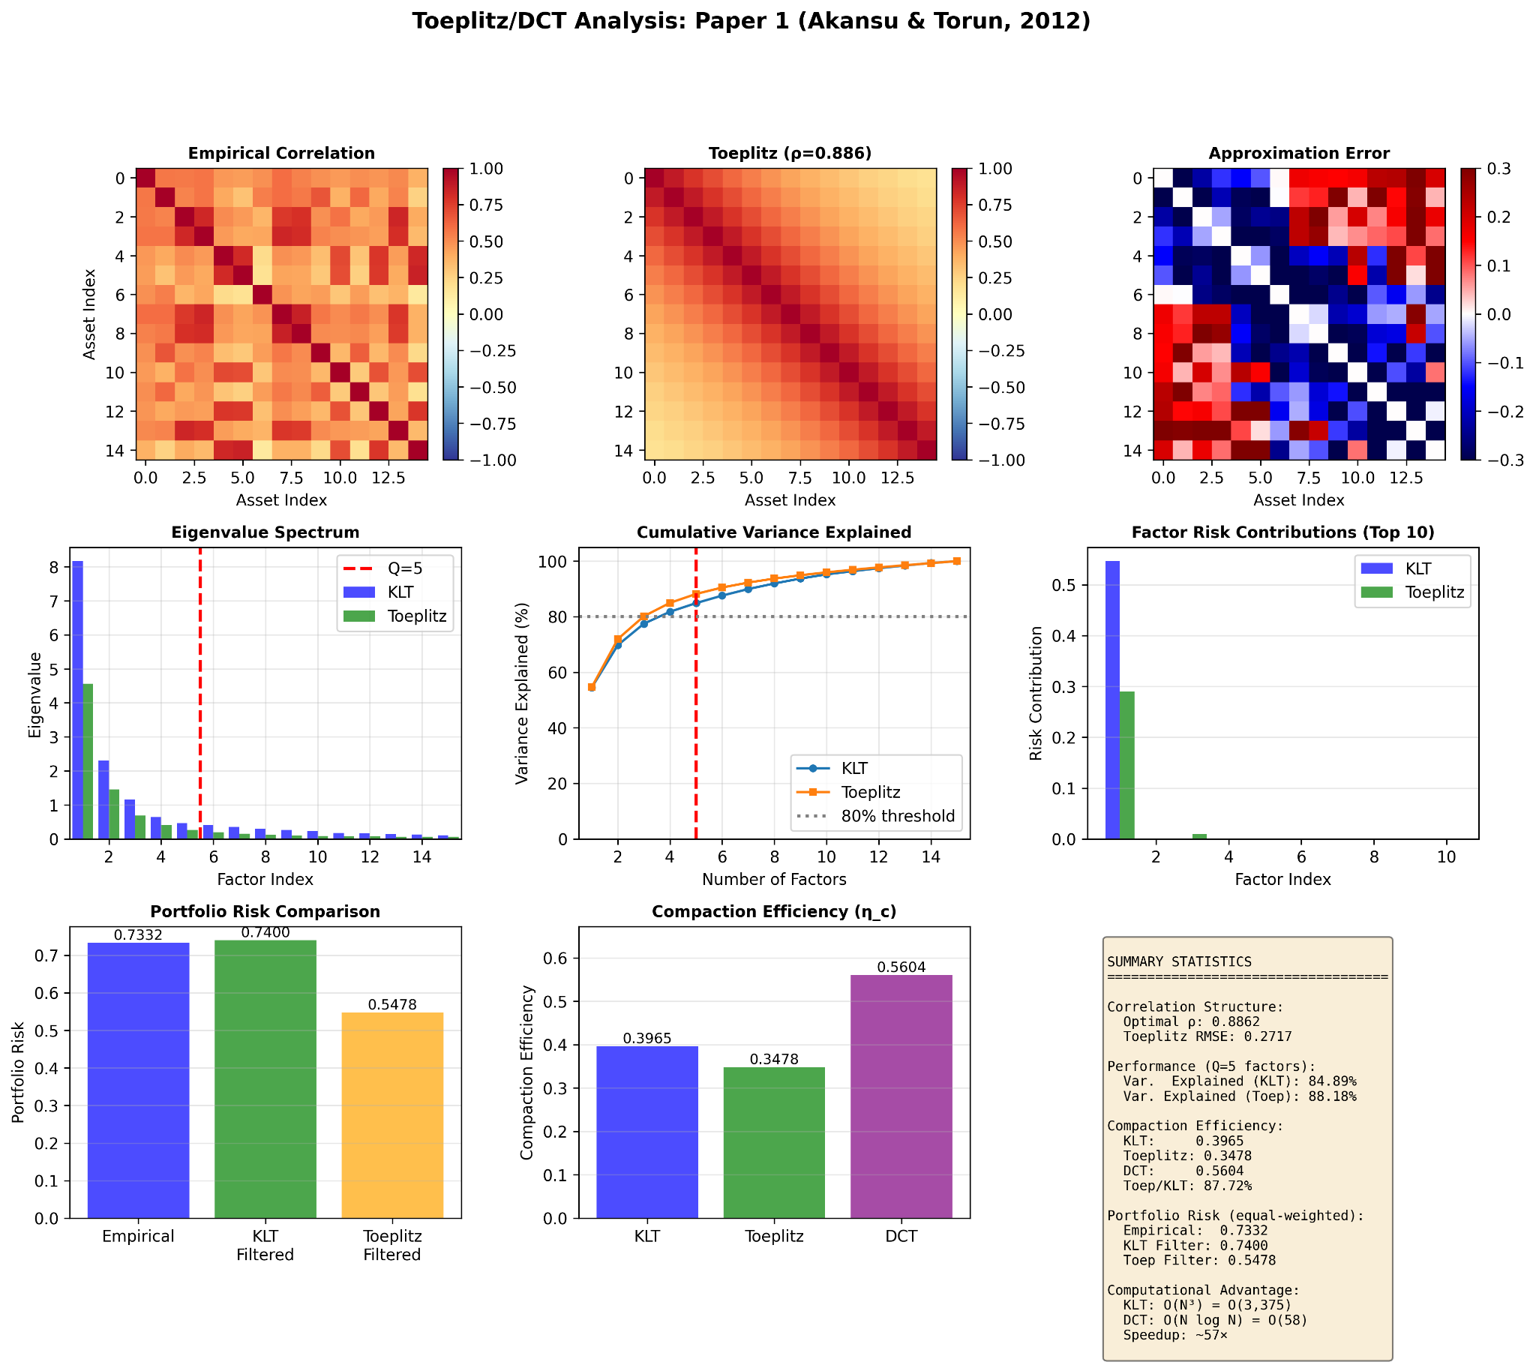
Output of the First Code

Slide 16
PAPER 2: π-COUNTING INSTANTANEOUS FREQUENCY FOR STOCK PREDICTION
CORE PROBLEM:
Traditional Hilbert Transform gives NEGATIVE frequencies for EMD's IMFs
Physically meaningless!
Cannot compute meaningful periods
Prediction models fail
THE SOLUTION:
π-Counting Instantaneous Frequency (π-IF)
Based on GEOMETRY (extrema counting), not phase
Always POSITIVE by construction
Enables accurate cycle extraction
Component-wise prediction: 99.3% error reduction
RESULTS:
Dataset: Hang Seng Index (253 days Hong Kong Stock Exchange)
Method: EMD + π-IF + RBF Neural Networks
Using Backpropagation NN 144× better predictions!

Slide 17
WHY TRADITIONAL IF FAILS
HILBERT TRANSFORM APPROACH:
Step 1: Form analytic signal
z(t) = x(t) + j·H[x(t)]
where H[x(t)] = Hilbert Transform
Step 2: Extract phase
z(t) = A(t)e^{jφ(t)}
φ(t) = arctan(H[x(t)]/x(t))
Step 3: Compute IF
ω(t) = dφ(t)/dt [rad/sample]
THE PROBLEM:
For IMFs from EMD: ω(t) < 0 frequently occurs!
CONSEQUENCE: Cannot compute period T = 2π/|ω| for ω < 0

Slide 18
SIMPLE WAVES TO THE RESCUE !
DEFINITION (Simple Wave):
A function f(t) is a Simple Wave on interval I if:
f is CONTINUOUS on I
f has only STRICT local extrema (no plateaus)
f is MONOTONE between consecutive extrema
f has FINITELY many extrema in any bounded interval
Every IMF is a Simple Wave
PROPERTIES:
• Well-defined half-periods between extrema
• Unique local max/min identification
• Enables vibration counting
• No phase ambiguity
SEPARABLE INTERVALS:
Set of intervals {(a₁,b₁), (a₂,b₂), ..., (a_{k},b_{k})} is α-INCREASINGLY SEPARABLE if:
f is strictly INCREASING on each (a_{i},b_{i})
f is strictly DECREASING between intervals
Maximum α-count:
α(f,I) = sup{k : ∃ α-inc-sep set of size k}
Similarly: β(f,I) for decreasingly separable
COMBINED VIBRATION COUNT:
N(f,I) = max{α(f,I), β(f,I)}
LOCAL WINDOW COUNT:
For point t and window half-width h:
Nₕ(t) = N(f, [t-h, t+h])

Slide 19
THE π-COUNTING FORMULA
CRITICAL WINDOW DEFINITION:
h*(t) = sup{h : Kₕ(t)·χ_{Nₕ(t)≥3}(h) = 0}
where:
Nₕ(t) = Number of extrema in [t-h, t+h]
Kₕ(t) = ⌊Nₕ(t)/2⌋ = Number of complete cycles
χ_{A}(·) = Indicator function (1 if A true, 0 otherwise)
INTERPRETATION:
h*(t) = Largest window where Kₕ = 0 OR Nₕ < 3
= Largest window with < 1 complete cycle
π-COUNTING INSTANTANEOUS FREQUENCY:
IFπ(t) = π/(2h*(t)) [rad/sample]
PERIOD EXTRACTION:
T(t) = 2π/IFπ(t) = 4h*(t) [samples]

Slide 20
EMPIRICAL MODE DECOMPOSITION
SIFTING ALGORITHM
Input: Signal x(t)
Output: IMFs {c₁(t), c₂(t),.., cₖ(t)} + residual r(t)
FOR each IMF k:
h(t) ← x(t) [or residual from previous IMF]
REPEAT (sifting):
1. Find all local MAXIMA of h(t)
2. Find all local MINIMA of h(t)
3. Interpolate maxima → upper envelope e_{max}(t)
4. Interpolate minima → lower envelope e_{min}(t)
5. Compute mean: m(t) = [e_{max}(t)+e_{min}(t)]/2
6. Update: h_new(t) = h(t) - m(t)
7. Check stopping:
SD = Σ_{t} |h(t) - h_new(t)|²/h²(t)
IF SD < 0.3: cₖ(t) ← h_{new}(t), BREAK
ELSE: h(t) ← h_new(t), CONTINUE
x(t) ← x(t) - cₖ(t) [residual for next IMF]
IMF CONDITIONS:
1. #extrema ≈ #zero-crossings (differ by ≤1)
2. Mean of envelopes ≈ 0 everywhere
FREQUENCY ORDERING:
IMF₁ → Highest frequency (fastest
oscillations)
IMF₂ → Lower frequency
...
IMFₖ → Lowest frequency
Residual → Non-oscillatory trend
IMF₁: noise dominates
Low-frequency components (IMF₄₋₇ + Residual) are predictable
Driven by fundamental economic cycles

Slide 21
RBF Neural Network Prediction
RBF NETWORK ARCHITECTURE:
Input Layer: x = [x₁, x₂, ..., xₚ]ᵀ where
p = Primary cycle Tₖ
Hidden Layer: Radial Basis Functions
φ_{j}(x) = exp(-‖x - cⱼ‖²/(2σ_{j}²))
Output Layer: Linear combination
ŷ = Σⱼ₌₁ᴺʰ wⱼφⱼ(x) + b
TRAINING (Two Phases):
Phase 1: Unsupervised - Find centers cⱼ
Method: K-means clustering on training
inputs
K-means objective: min Σ_{i} Σ_{j}ⱼ ‖x_{i} - c_{j}‖²
Result: N_{h} centers {c₁, c₂,...,c_{nh}}
Phase 2: Supervised - Solve for weights w_{j}
Linear system: Φ_{w} = y
where Φ_{ij} = φ_{j}(x_{i}) [RBF activation matrix]
Closed-form solution:
w = (ΦᵀΦ)⁻¹Φ^{T}y [Normal equations]
NO ITERATIVE OPTIMIZATION! (unlike
backpropagation)
Works best to find IMF₄₋₇ components as they
can be trained on RBF to ensure better
prediction.

Slide 22
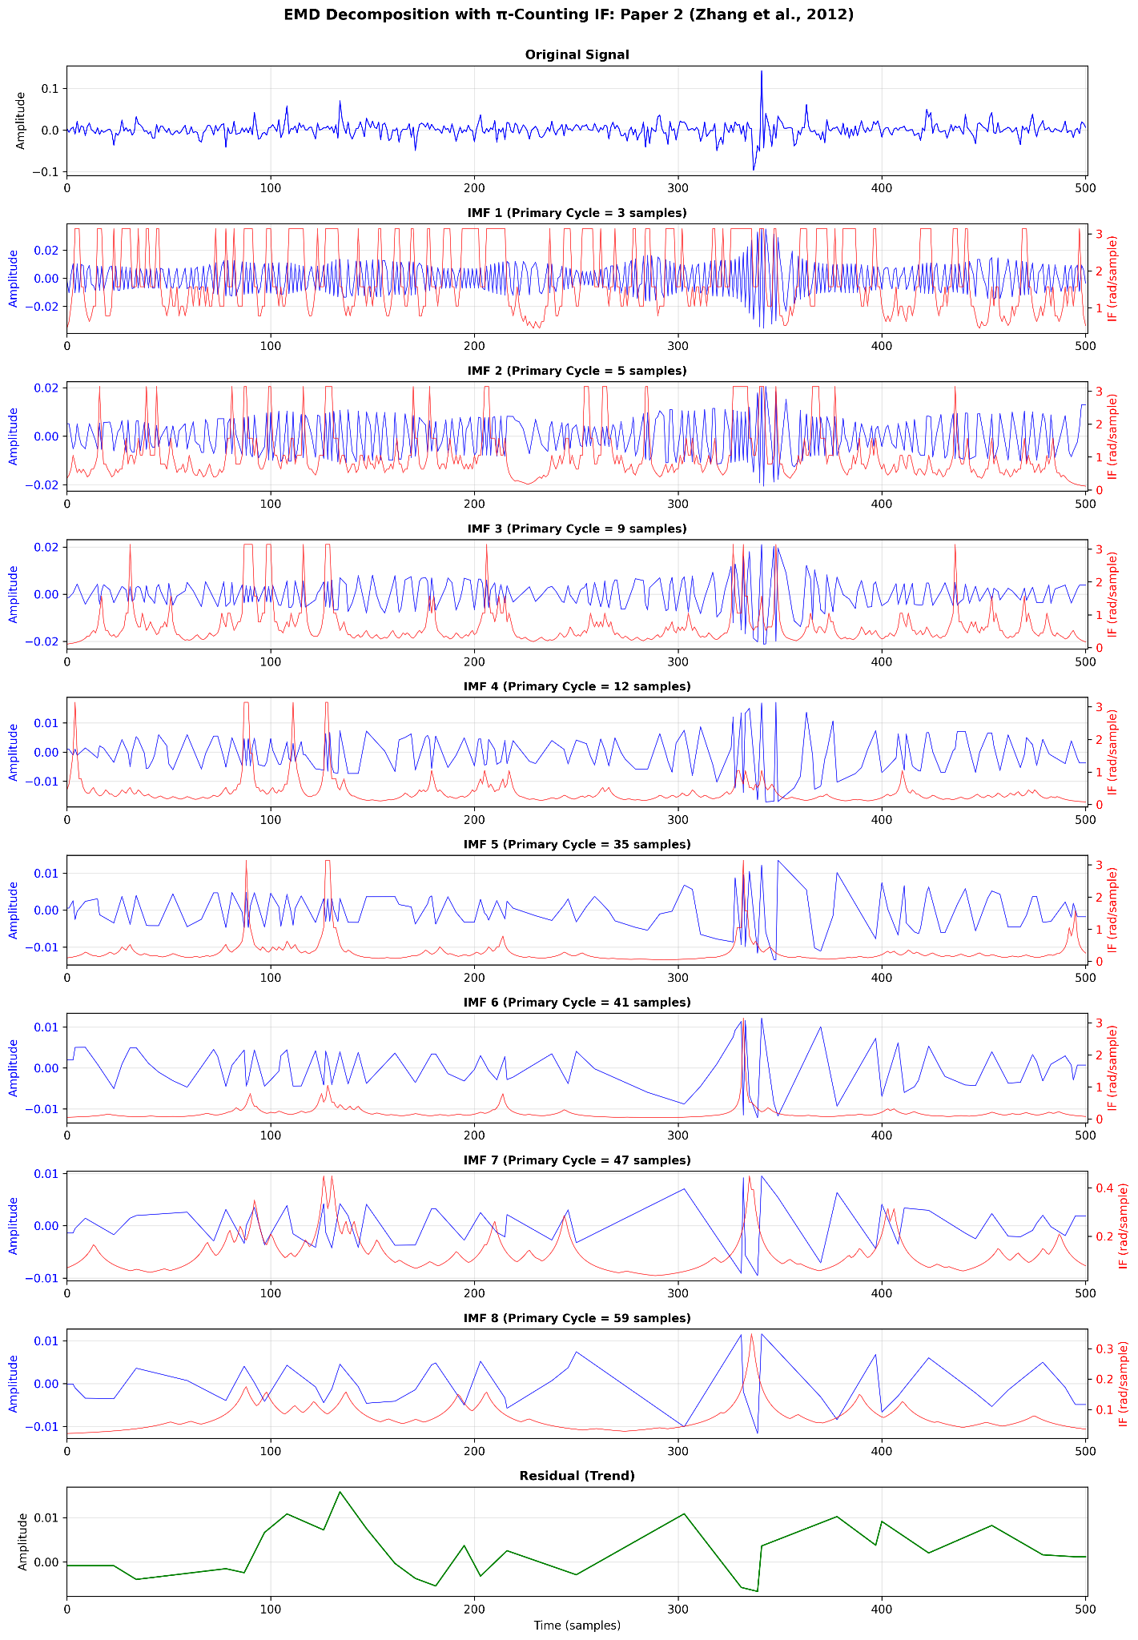
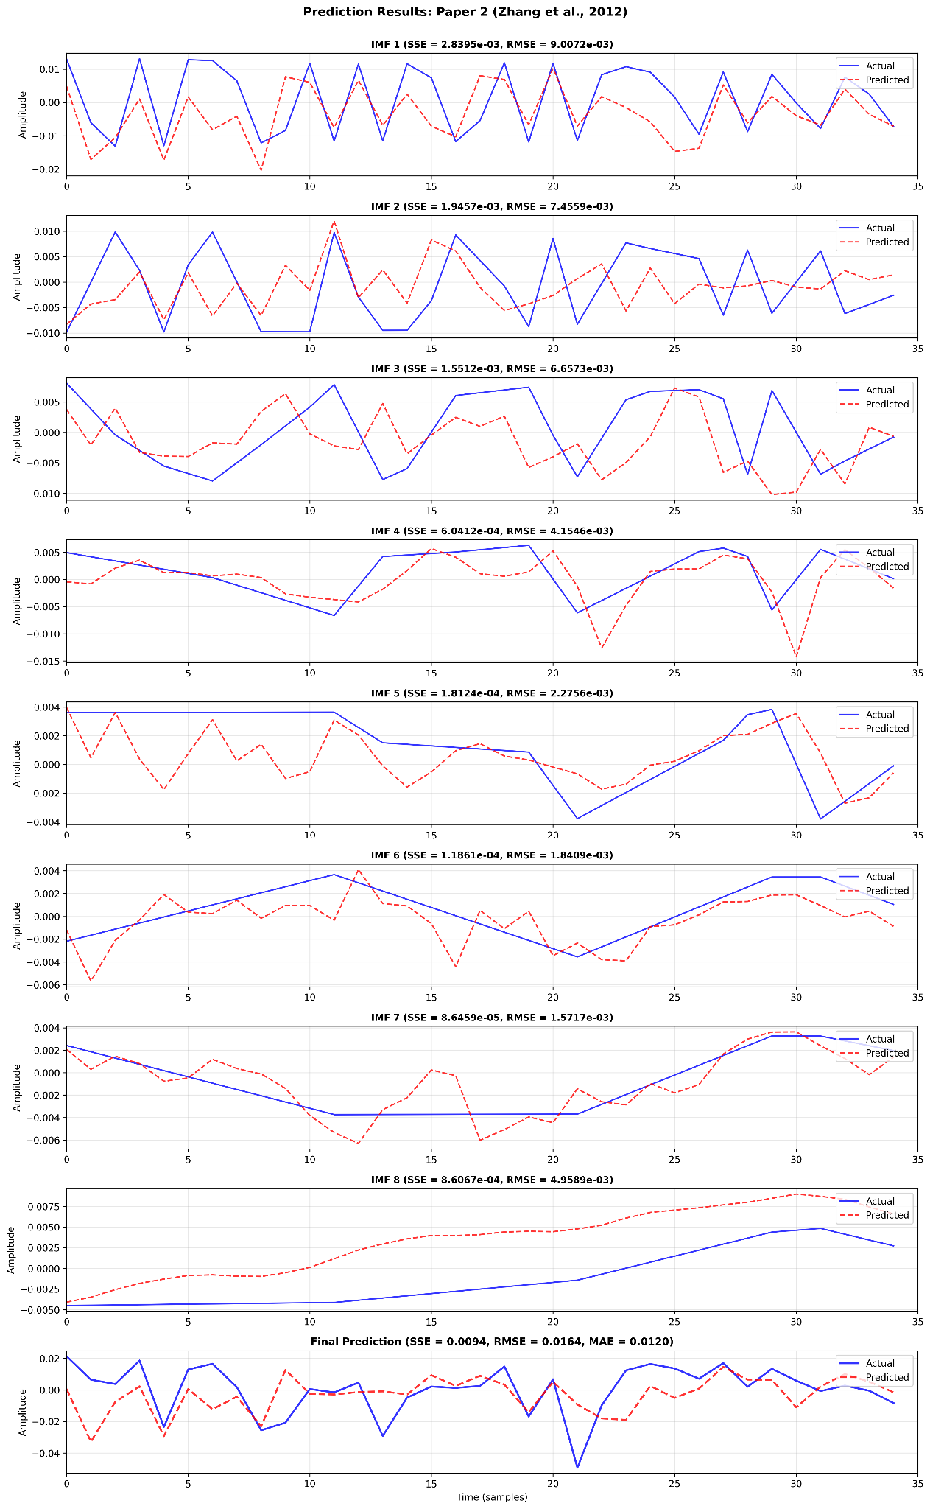

Slide 23
LANGEVIN DYNAMICS FOR HIGH-FREQUENCY FUTURES TRADING
CORE PROBLEM:
Traditional momentum strategies miss two critical features:
MEAN REVERSION: Trends don't persist forever, they decay
JUMPS: Sudden trend reversals due to news/events
THE SOLUTION:
Langevin Jump-Diffusion Model + Variable Rate Particle Filter (VRPF)
State: [v(t), θ(t)] = [Price, Trend]
Dynamics: dθ = -αθ dt + σ_{θ} dW + dJ (mean reversion + diffusion + jumps)
Inference: Rao-Blackwellized particle filter
Trading: Signals from trend estimates
RESULTS:
Dataset: 75 futures contracts, 8 sectors, 5 years (2006-2011)
Performance: Sharpe Ratio = 1.83 (post-transaction costs)
Comparison: 83% BETTER than typical hedge fund (Sharpe ≈ 1.0)

Slide 24
WHY SIMPLE MOMENTUM FAILS
OBSERVATIONS IN FINANCIAL MARKETS:
1. MOMENTUM: Prices exhibit short-term trends
like crude oil prices.
2. MEAN REVERSION: Trends eventually decay to
Zero. Google stock after 3 day rally,the
Momentum weakens.
3. JUMPS: Sudden reversals due to discrete
events. After Fed announcement the trend
reverses instantly.
WHAT WE NEED:
A continuous-time model with:
Trend variable θ(t) that persists
Mean reversion parameter α (trend decay rate)
Diffusion σ_{θ} (random trend changes)
Jump process with rate λ (sudden shifts)
TRADITIONAL APPROACHES & THEIR FAILURES:
Method | What it captures | What it misses
Moving average | Trend direction | Lags behind,no jumps
ARIMA | Auto- correlation | Assumes stationarity
GARCH | Volatility | Not directional
Kalman Filter | Linear trends | No jumps (Gaussian)

Slide 25
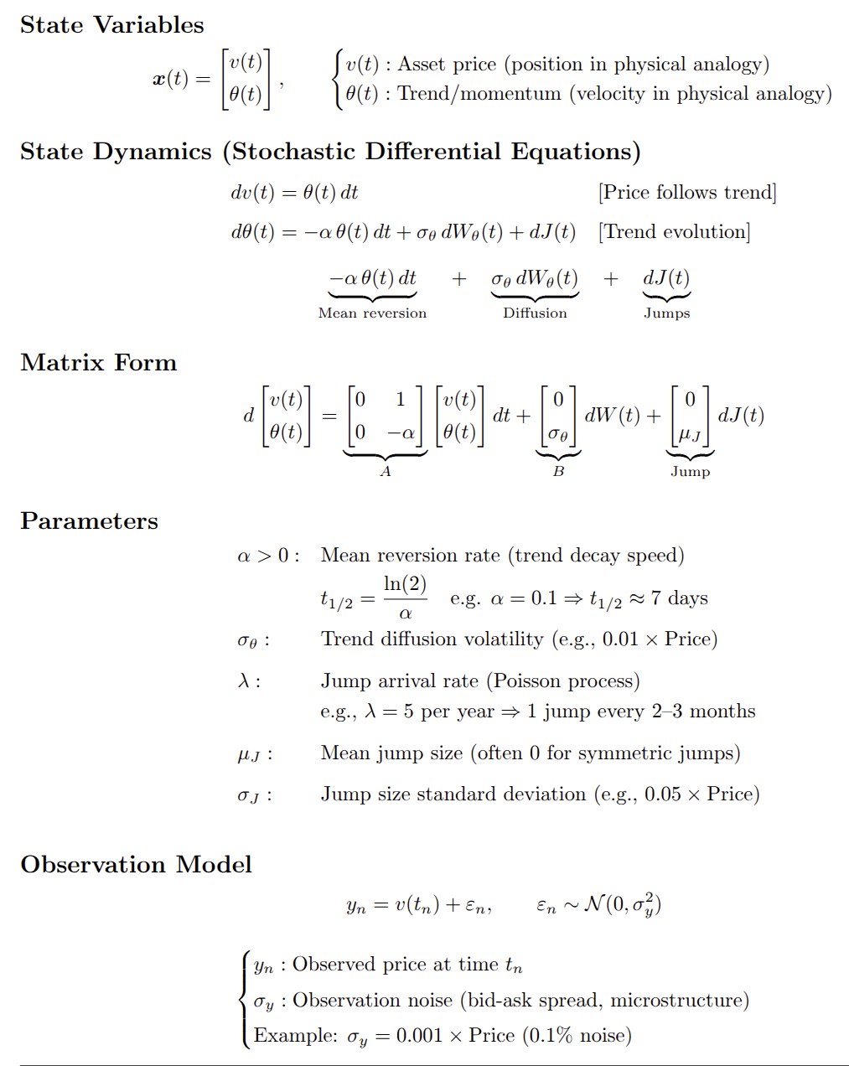
Langevin Jump-Diffusion Model
MEAN REVERSION EQUATION (without noise/jumps):
dθ(t) = -αθ(t)dt
Solution: θ(t) = θ(0)e^{-αt}
As t → ∞: θ(t) → 0 (trend dies out mean reversal)

Slide 26
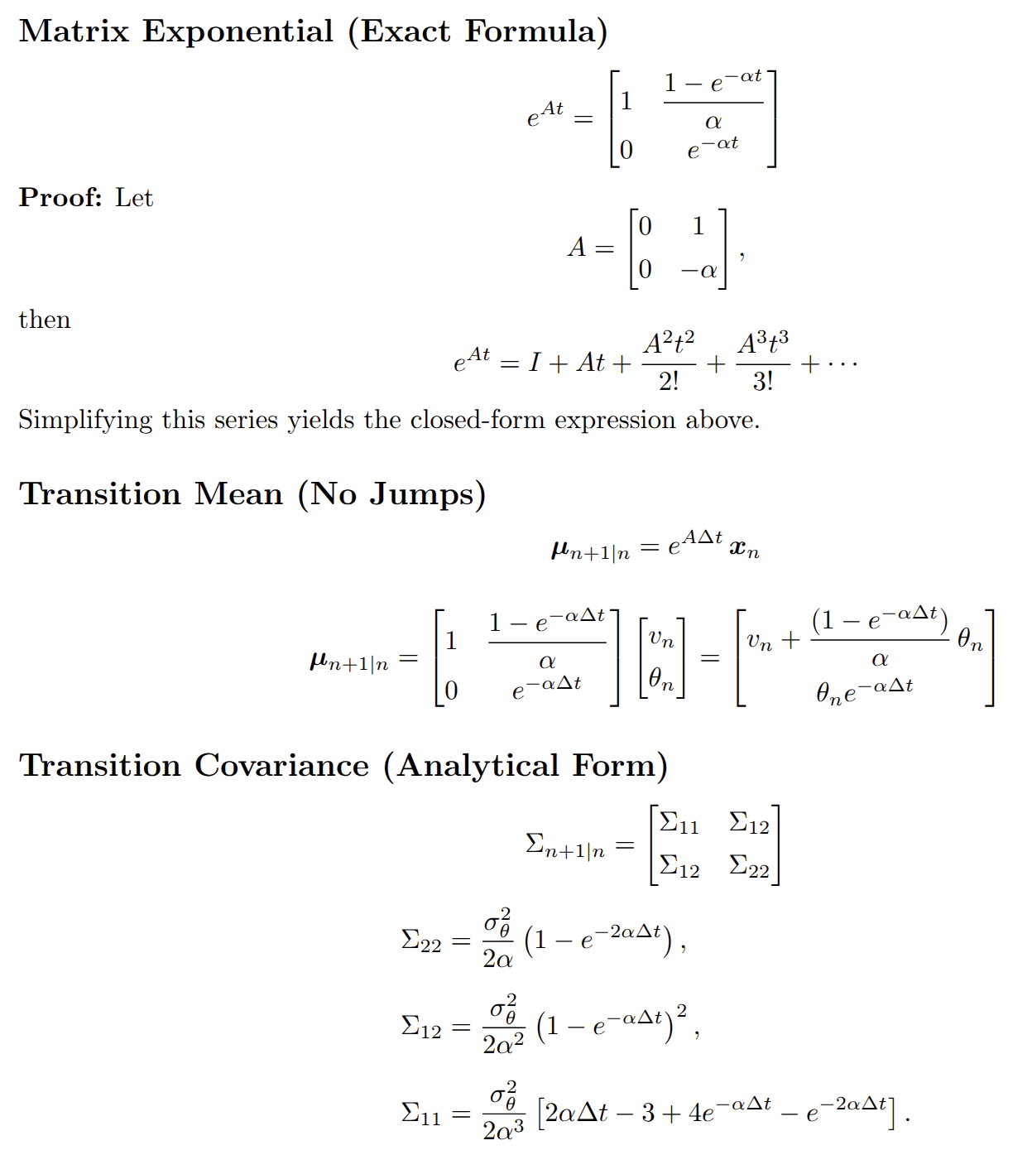
MODELING SUDDEN TREND REVERSALS
ANALYTICAL SOLUTION BETWEEN JUMPS
POISSON JUMP PROCESS:
N(t) ~ Poisson(λ) [Number of jumps in [0,t]]
P(N(t) = k) = (λt)^{k} e^{-λt}/k!
Inter-arrival times: τ_{i} ~ Exponential(λ)
P(τ > t) = e^{-λt}
JUMP SIZE DISTRIBUTION:
When jump occurs at time τ:
ΔJ ~ N(μ_{J}, σ_{J}²)
Total jump contribution:
dJ(t) = μ_{J}dN(t)+σ_{J} √(dN(t))ε_{t}, ε_{t} ~ N(0,1)
INTERPRETATION:
• dN(t) = 1 if jump at time t, else 0
• If jump: Δθ = μ_{J} + σ_{J} × (random ± value)
• μ_J = 0: Symmetric jumps
• μ_J ≠ 0: Directional bias

Slide 27
INFERENCE VIA RAO-BLACKWELLIZED PARTICLE FILTER
WHY PARTICLE FILTER?
Problem: Jump times{τ₁,τ₂,..} are DISCRETE and
UNKNOWN. p(x, {τ} | y_{{1:n}}) is NON-GAUSSIAN.
In such scenarios the standard Kalman Filter FAILS as it assumes Gaussian.
RAO-BLACKWELLIZATION IDEA:
Separate state into:
1. PARTICLES: Sample jump times (non-Gaussian part)
2. KALMAN: Track (v, θ) given jumps (Gaussian part)
Now we define for each particle:
{τ^{(i)}, m^{(i)}, Σ^{(i)}, w^{(i)}}
τ^{(i)}: Jump time history for particle i
m^{(i)}: Kalman posterior mean
Σ^{(i)}: Kalman posterior covariance
w^{(i)}: Particle weight (importance)

Slide 28
VARIABLE RATE PARTICLE FILTER ALGORITHM
STEP 4: KALMAN UPDATE (per particle)
For each particle (jumping or merged):
4a. PREDICT:
Compute transition using closed-form formulas
If jumping: Account for jump at τ^{(i)}
m_{{n+1|n}}^{(i)} = f(m_{n}^{(i)}, τ^{(i)})
Σ_{{n+1|n}}^{(i)} = g(Σ_{n}^{(i)}, τ^{(i)})
4b. UPDATE (Kalman):
Innovation: ν = y_{{n+1}} - H·m_{{n+1|n}}^{(i)}
Innovation covariance: S = H·Σ_{n+1|n}^(i)·Hᵀ + σ_{y}²
Kalman gain: K = Σ_{{n+1|n}}^{(i)}·H^{T}·S⁻¹
Updated mean: m_{{n+1}}^{(i)} = m_{{n+1|n}}^{(i)} + K·ν
Updated covariance: Σ_{{n+1}}^{(i)} = Σ_{{n+1|n}}^{(i)} - K·S·K^{T}
4c. REWEIGHT:
Likelihood: L^{(i)} = N(ν; 0, S) [Gaussian PDF]
New weight: w_{{n+1}}^{(i)} = w_{n}^{(i)} × L^{(i)}
STEP 5: NORMALIZE
w^{(i)} ← w^{(i)}/Σ_{j}w^{(j)}
STEP 1: RESAMPLE
For each particle i:
Offspring count: n_i ~ Poisson(N_p × w^{(i)})
(Stochastic universal sampling for low variance)
STEP 2: PROPOSE JUMP TIMES
For each offspring:
Sample τ_{new} ~ Exponential(λ)
If τ_{new} < Δt: Mark as "jumping"
Else: Mark as "non-jumping"
STEP 3: COLLAPSE NON-JUMPING PARTICLES
Merge all non-jumping offspring and consider
them as single particle
Weight: w_{merged} = Σ(weights of non-jumping)
State: (m_{merged}, Σ_{merged}) = same for all
Reason: Identical dynamics implies Redundant particles so eliminate them

Slide 29
TRADING SIGNAL GENERATION PIPELINE
STEP 4: VOLATILITY SCALING
Final signal: s_{final}(t) = s_{tanh}(t) / σ_{vol}(t)
where σ_{vol}(t) from IGARCH(1,1):
σ²_{vol}(t) = ω + β·σ²_{vol}(t-1) + α·(r(t-1) - μ)²
with α + β = 1 (integrated GARCH)
POSITION SIZING:
Number of contracts: N(t) = s_{final}(t) × (TargetVol / σ_{vol}(t)) × Capital / ContractValue
STEP 1: SIGN OF TREND CHANGE
Raw signal: s_{raw}(t) = sign(v̂(t) - v̂(t-1))
= sign(θ̂(t)) [approximately]
STEP 2: FIR SMOOTHING (Moving Average)
s_{smooth}(t) = (1/L)Σ_{{k=0}}^{{L-1}} s_{raw}(t-k)
Benefit: Reduces noise, avoids whipsaws
STEP 3: NONLINEAR TRANSFORMATION
s_{tanh}(t) = tanh(s_{smooth}(t) / σ_{s})
where σ_{s} = std(s_{smooth}) over recent window
Purpose:
• Small signals: Linear response
• Large signals: Saturate (avoid over-betting)
• Mean reversion of signal itself

Slide 30
